Slide 1

Social inclusion and diversity –
from goodwill to institutional change
Pre-conference workshop
ECSITE Annual Conference 2017, Porto
Twitter:
#Ecsite2017 + #room6
Wednesday, 14 Jun 2017, 9:00 - 17:45

Slide 2
AGENDA
WHY US?
Introduction
Input and discussion (Maria Vlachou)
Self-evaluation workshop (Vanessa Mignan,
Matteo Merzagora)
Input and discussion (Marianne Achiam)
LUNCH BREAK
Sharing data (all)
Visualising exercise, workshop (Liz Rasekoala)
Workshop on framework process
(working groups)
Wrap-up, next steps
WHERE ARE
WE?
HOW CAN WE
PROGRESS?
WHAT ARE WE
AIMING AT?

Slide 3
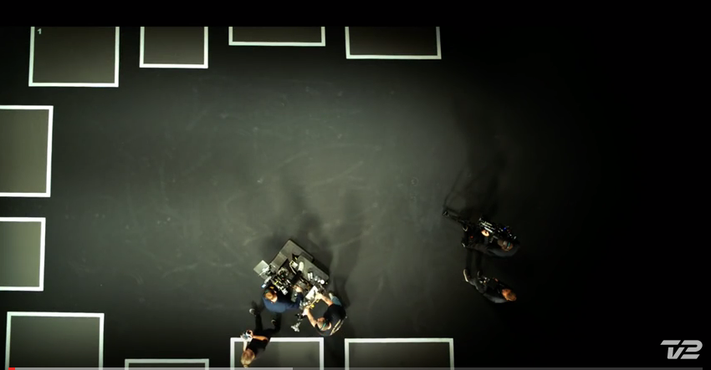
All that we share
https://www.youtube.com/watch?v=jD8tjhVO1Tc

Slide 4
OUR UNDERSTANDING
inclusion: state of being and feeling valued, respected and supported,
being a part of feeling ownership for
diversity: differences in gender, abilities, race, culture, believe/religion, social status, economic status, educational background, sexual preference, being pregnant/having a baby, political preference, specific life experiences, ...
continuum

Slide 5
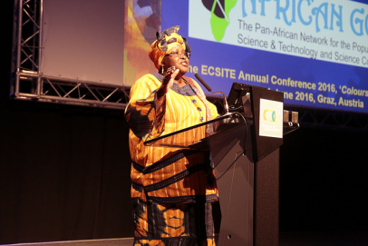
The process… towards a framework for diversity & social inclusion
field-wide institutional change
framework
documents
tools
pre-
conference
ad hoc session
advocate group
working group STRATEGY
working group CONTENT
working group STAFF
working group PARTNERSHIPS
working group ACCESS
June 2016 Graz
June 2017 Porto

Slide 6
The (intended) content…
of a framework for
diversity & social inclusion
INDICATORS
of inclusive practice
„What kind of change do / would we see, if an institution fully adopts social inclusion/diversity?“
structured by 5 institutional areas:
STRATEGY / CONTENT / STAFF / PARTNERSHIPS / ACCESS
TOOLKIT
of helpful resources
case studies
links
literature
self-evaluation tool
ADVOCACY
support
advocacy statement
typical barriers, traps, arguments – and how to counter them
short narratives describing effective change

Slide 7
Indicators - examples
To demonstrate their being strategically INCLUSIVE & DIVERSE on governance level institutions shall:
refer explicitly to diversity & social inclusion in the mission statement
include in the Board of trustees people of different genders, abilities, sexual preferences, social status, believes, culture
include representative of minority nearby community (at bus ride distance) in the governance bodies (as trustees, advisors or spokespeople)
at all levels include staff with diverse (dis)abilities
recognize the stereotypic understanding of diversity: avoid easy labelling (black, Muslim, low-income, disabled person), recognise intersectionality
…

Slide 8
working group STRATEGY: Antonia Caola, Bärbel Auffermann, Shaaron Leverment, Joana Lobo Antunes, Emanuel Reis, Liz Rasekoala, Barbara Streicher
working group CONTENT: Emanuel Reis, Mairead Hurley, Sheena Laursen, Vanessa Mignan, Iris Ott, Barbara Streicher
working group STAFF: Vanessa Mignan, Bärbel Auffermann, Antonia Caola
working group PARTNERSHIPS: Andy McLeod, Jo Bryant, Mairead Hurley, Shaaron Leverment, Joana Lobo Antunes, Vanessa Mignan, Iris Ott, Liz Rasekoala, Barbara Streicher
working group ACCESS: Sheena Laursen, Jo Bryant, Mairead Hurley, Shaaron Leverment, Andy McLeod

Slide 9
Next steps

Slide 10
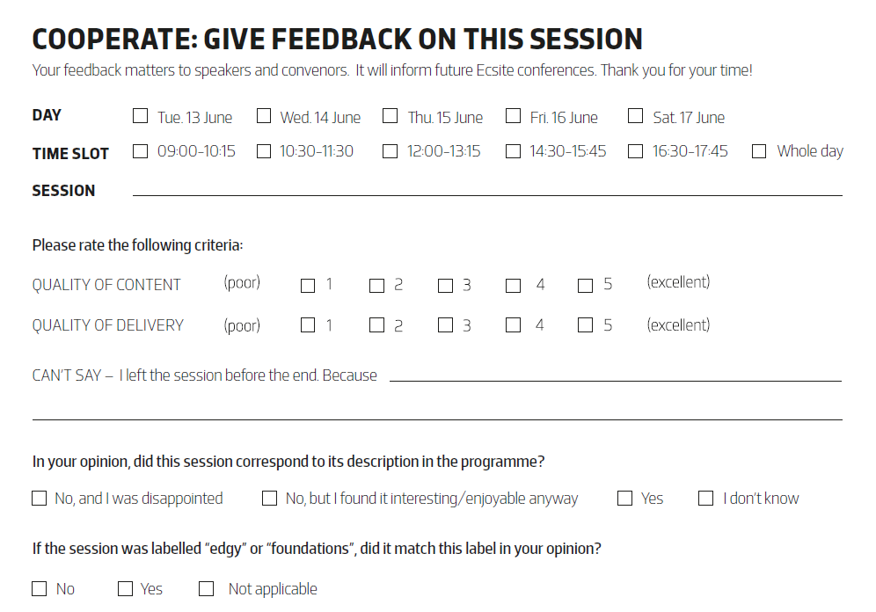

Thank you!
And before you leave...

Slide 11
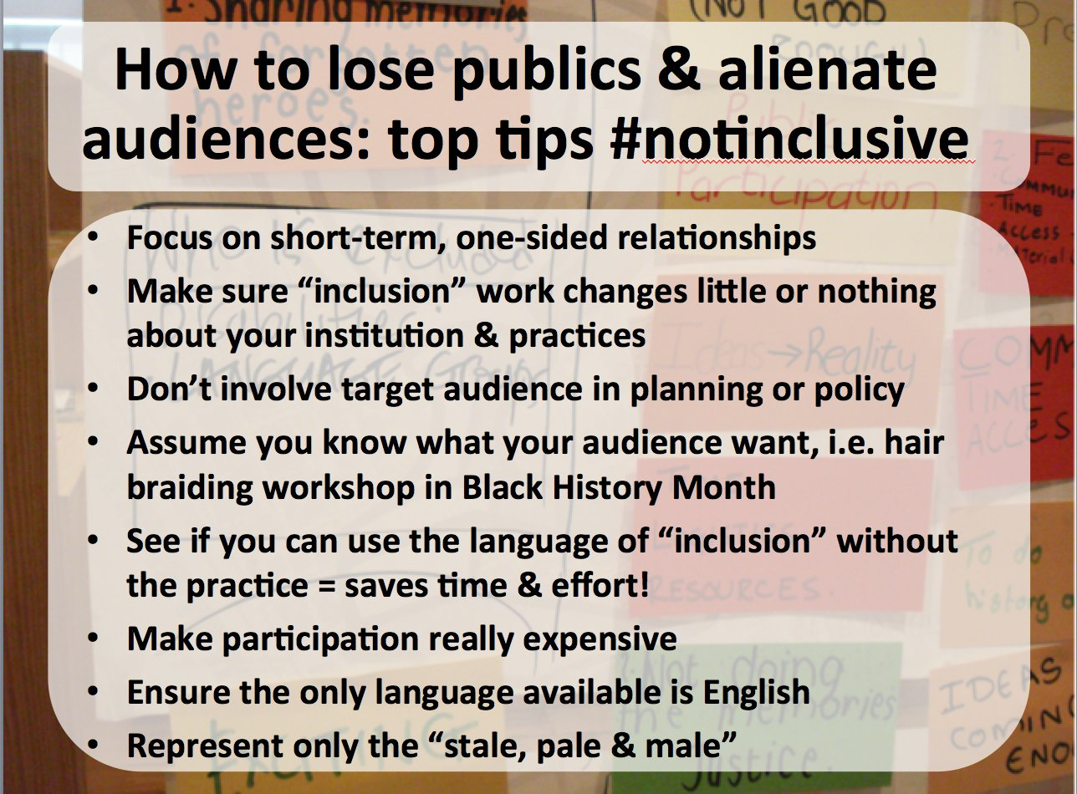

Slide 12
R-E-S-P-E-C-T
https://www.youtube.com/watch?v=6FOUqQt3Kg0

Slide 13
WAFIRA
https://youtu.be/BjmozBdgGog

